Slide 1

Revolutionizing Urban Logistics: Unlocking Efficiency in Last-Mile Delivery
Submitted by: Vishuwaesh Srinivasa Balaji

Slide 2
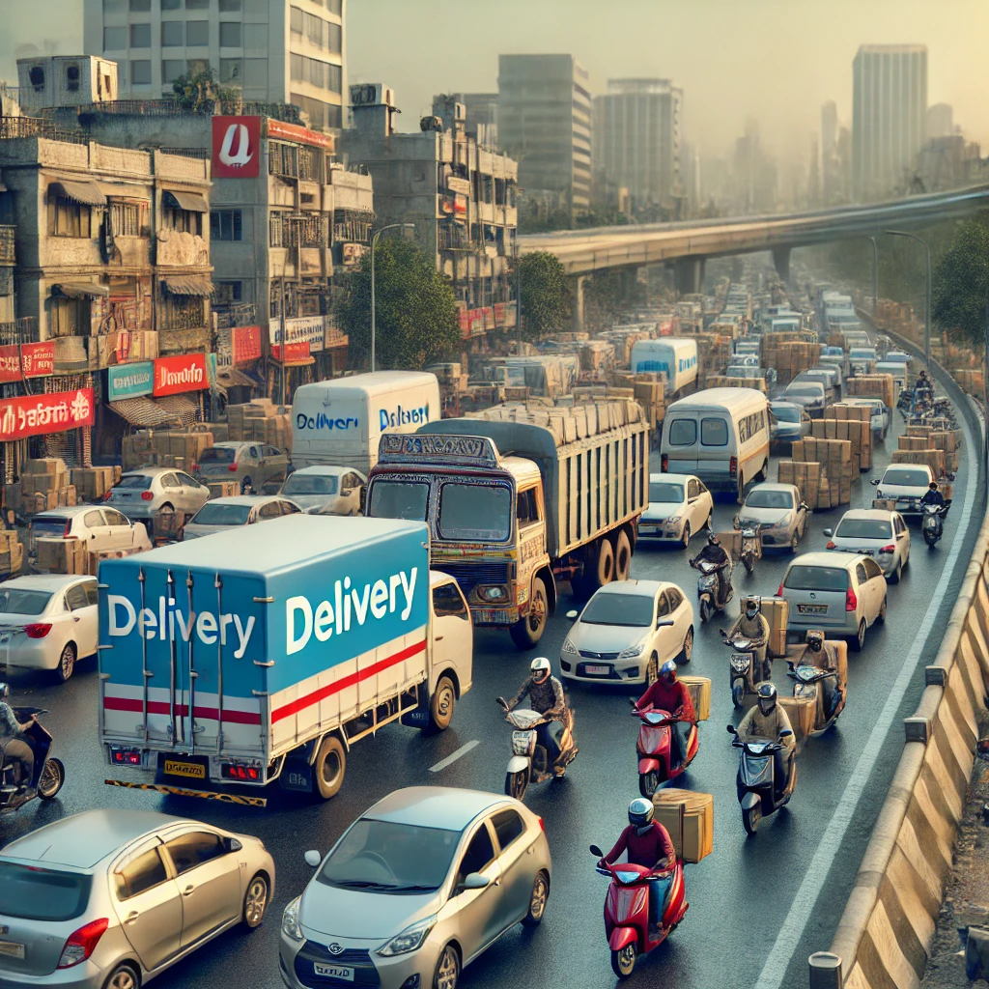
The Problem – Traffic Congestion in Urban Delivery
Key Issue: Traffic congestion causes 30% of delivery delays in major cities (Mumbai, Delhi, Bangalore).
Increased fuel costs and operational inefficiency.
Rising demand for same-day or 10-minute delivery (Blinkit, Zepto).
Impact: Missed delivery windows, reduced customer satisfaction.
Higher operational costs and emissions from idling vehicles.

Slide 3
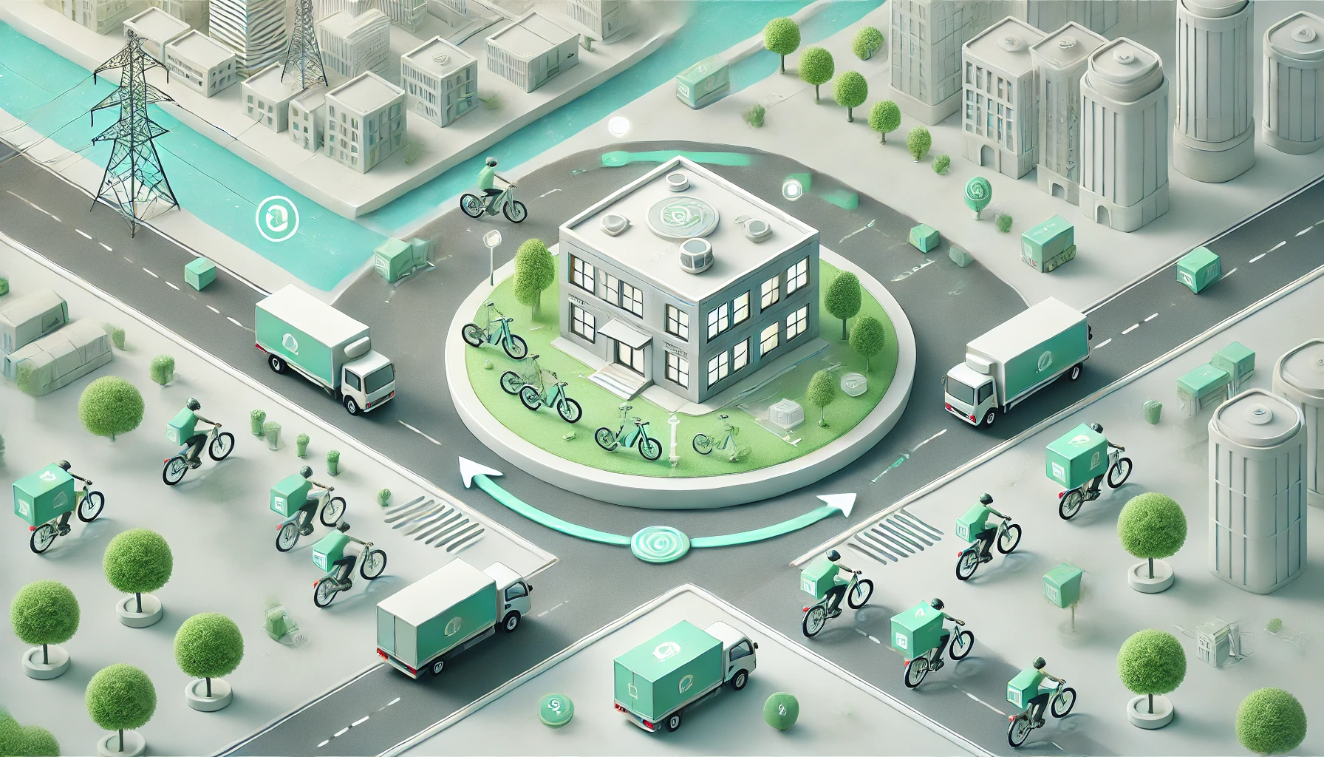
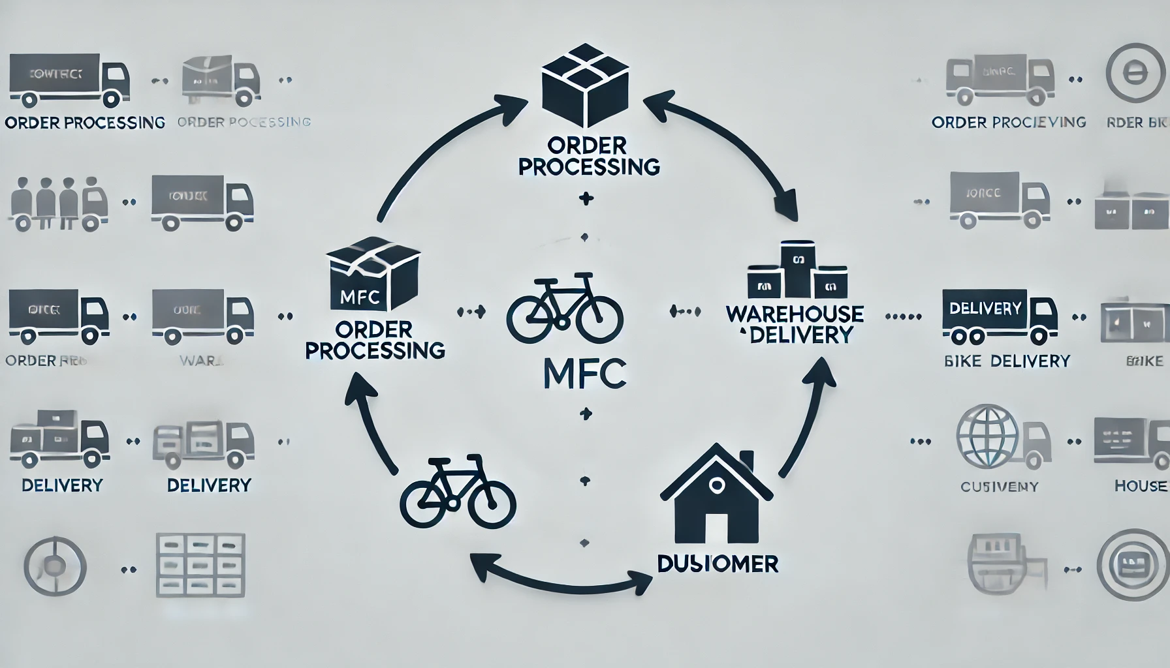
Proposed Solution – Micro-Fulfillment Centers (MFCs) and Electric Fleets
Solution Overview: Establish Micro-Fulfillment Centers (MFCs) in high-demand areas.
Use electric bikes and bicycles for hyperlocal deliveries to bypass traffic.
How It Works: MFCs store fast-moving SKUs, reducing long-distance deliveries.
EV/Bike Fleets ensure eco-friendly, faster delivery even during peak hours.

Slide 4
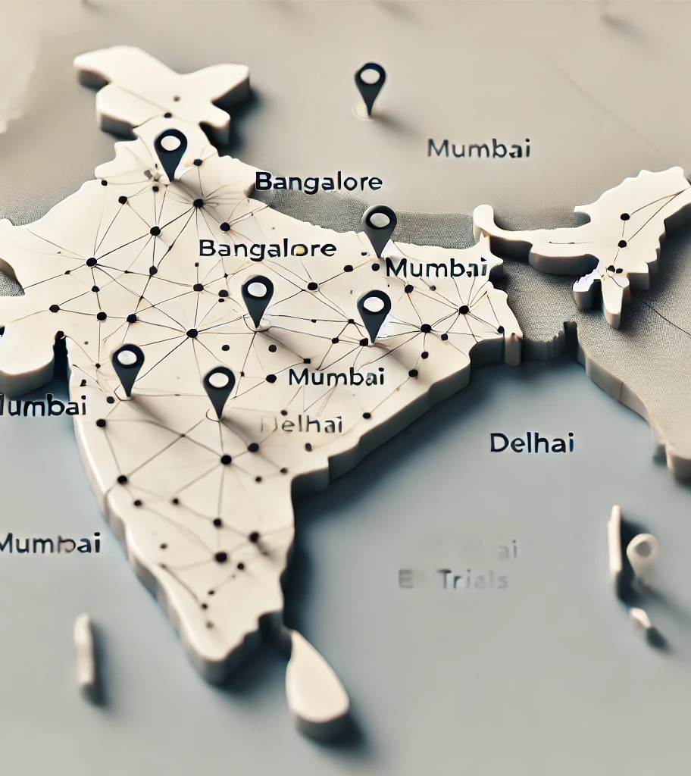
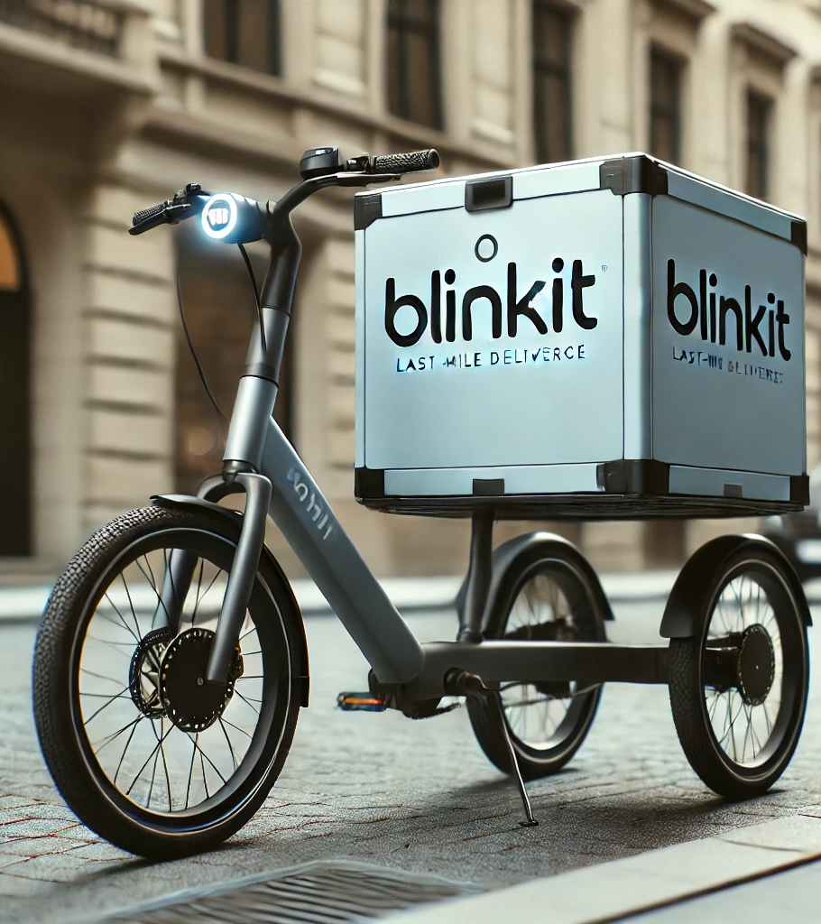
Real-World Examples of Success
Blinkit/Zepto: 10-minute delivery using MFCs across metro cities.
Amazon India: Urban parcel lockers to reduce last-mile congestion.
Swiggy/Zomato: EV bikes and bicycle deliveries in Bangalore and Mumbai.
Delhivery: AI-driven route optimization to bypass traffic bottlenecks.

Slide 5
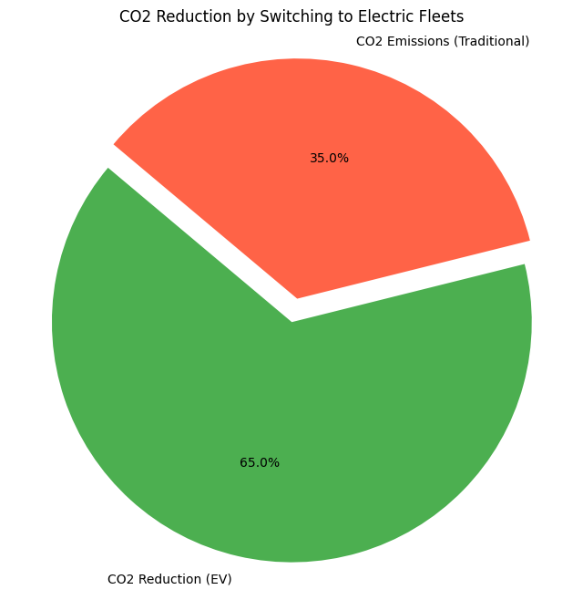
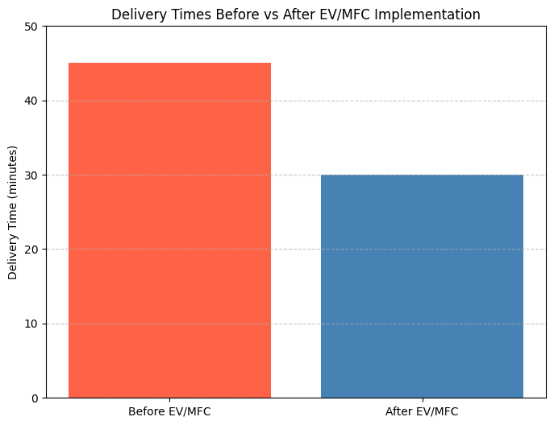
Projected Impact and Results
20-30% Faster Deliveries in peak hours.
15-25% Fuel Savings due to shorter routes and the use of bikes/EVs.
30% Lower Carbon Emissions – shift to electric fleets.
Increased Delivery Success Rates by avoiding congested areas.

Slide 6
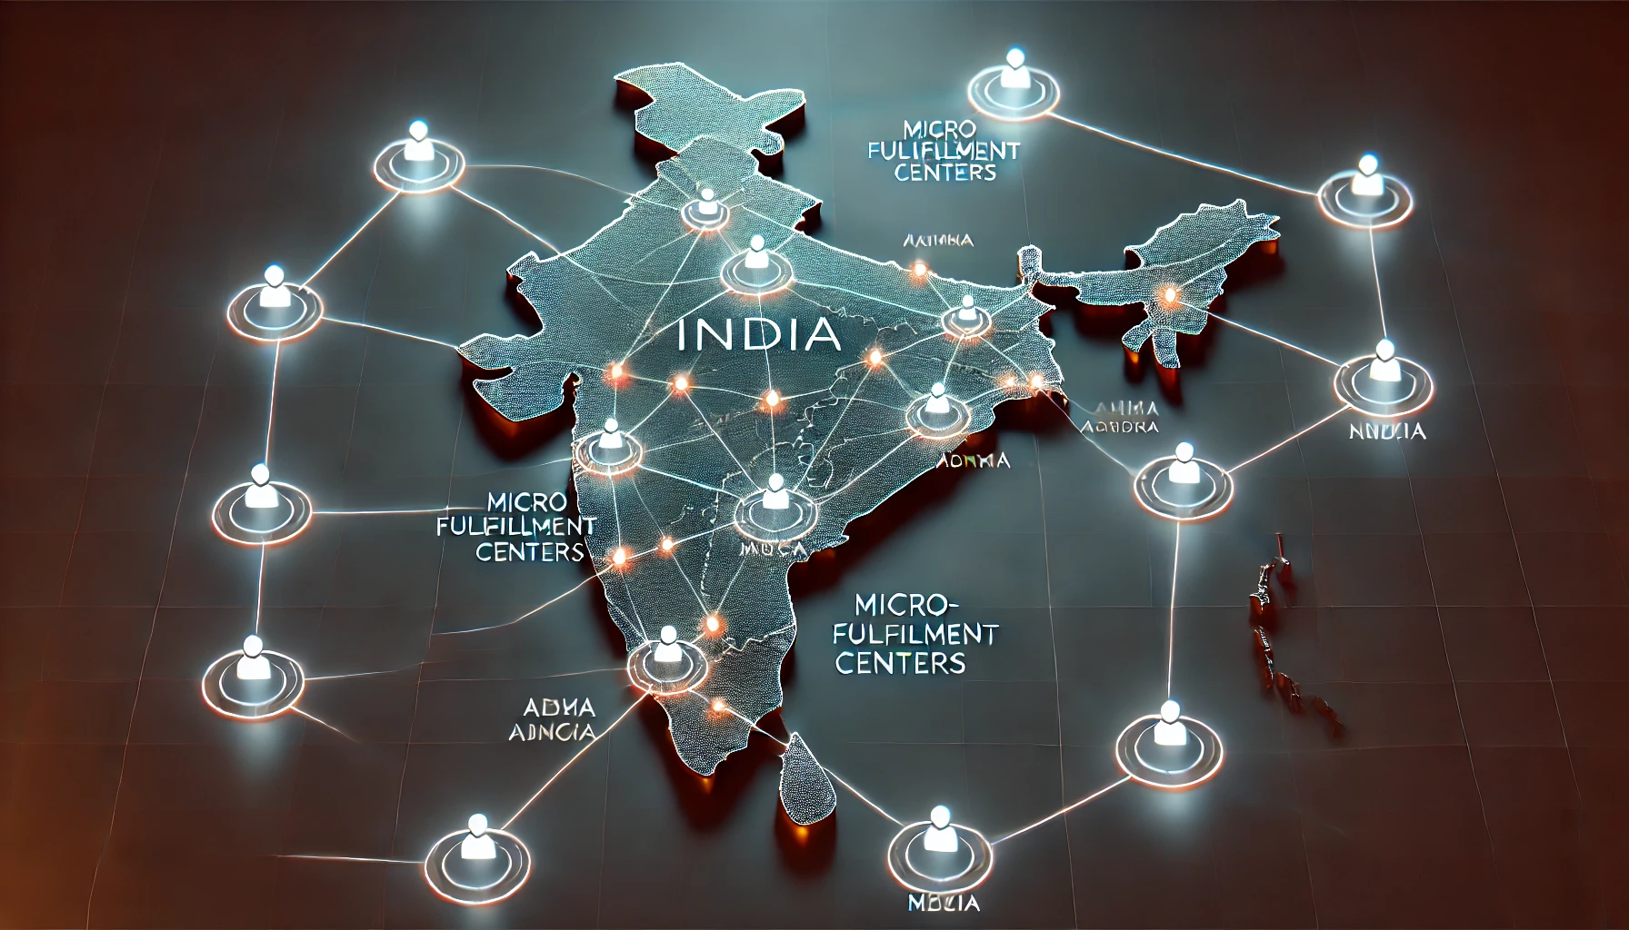
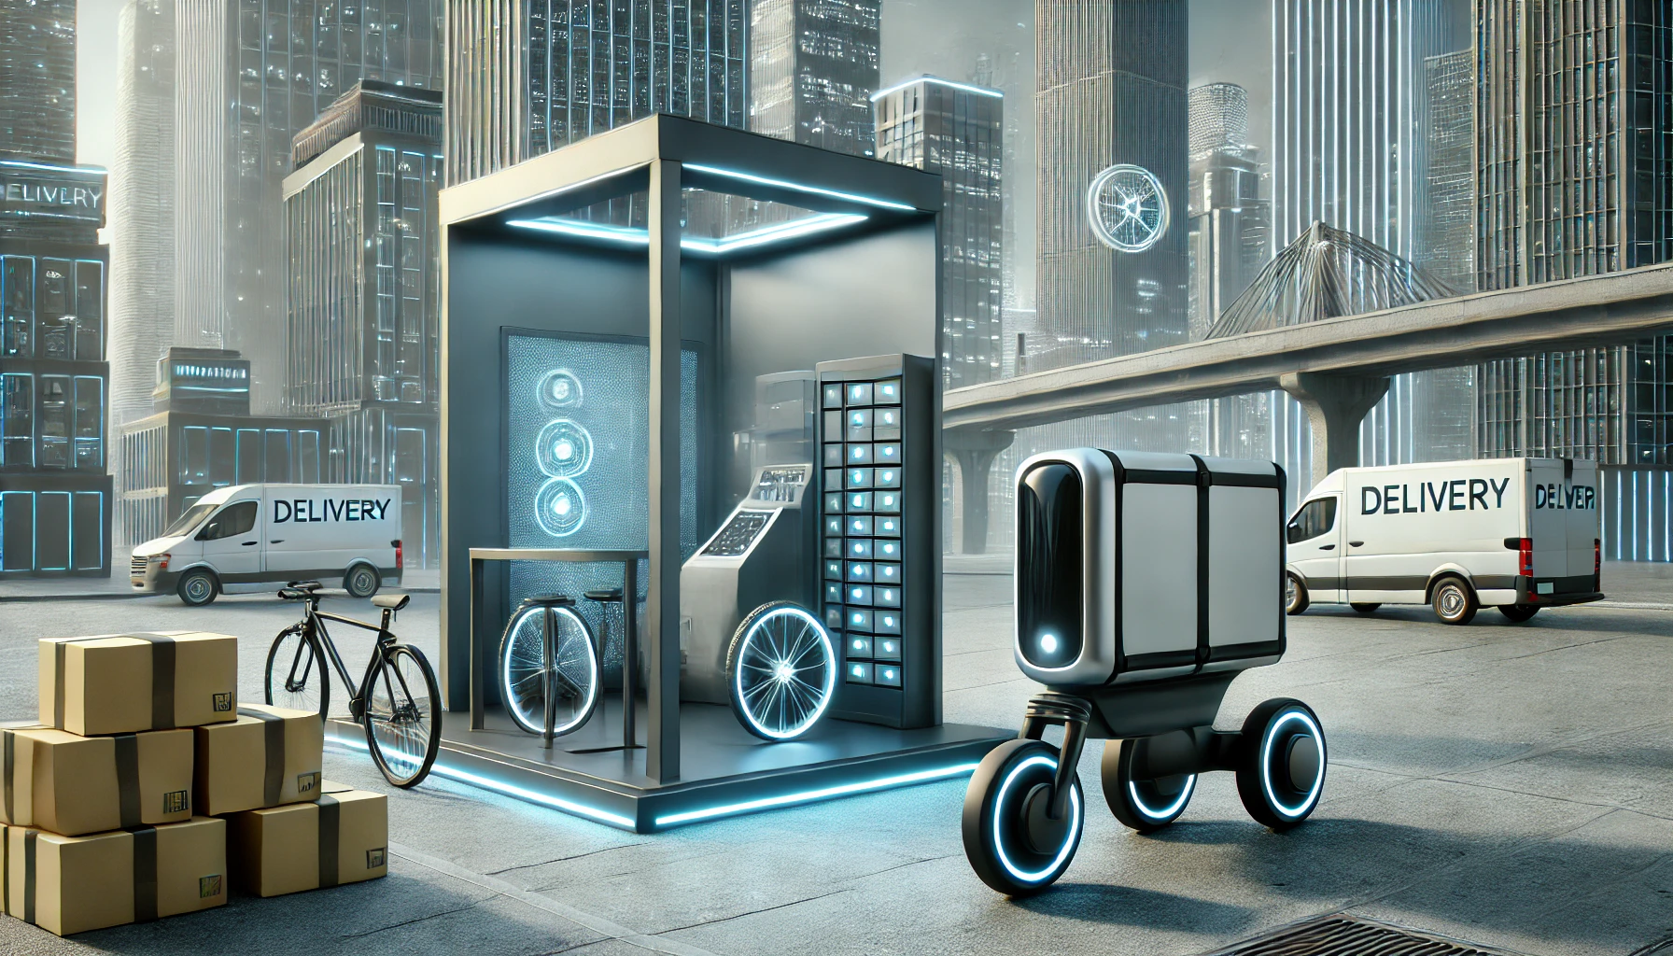
Future Outlook and Scalability
Scaling MFCs to Tier-2 cities for quicker reach.
Expanding EV Fleets with government incentives for green logistics.
AI Route Optimization – enhance live traffic data analysis for better route planning.

